Slide 1
Testing Concepts
Lesson 6: Requirement Engineering

Slide 2
Lesson Objectives
To understand the following topics:
Evolution of Requirements
Who provides the Requirements?
Challenges in Requirement Gathering
Why do we need good requirements?
o Characteristics & Impact of bad Requirements
Requirement engineering
Functional Vs Non-Functional Requirements
Non Functional Requirements: FURPS +

Slide 3
Lesson Objectives
Stable and Volatile Requirements
Baselining Requirements
Requirements Traceability
Requirement Traceability Matrix
Maintaining Requirement Traceability
Requirement Traceability Matrix – Example
Requirements Change
Change Management Process
Requirement Creep

Slide 4








6.1 Evolution of Requirements
A business pain area to be rectified. A solution-
Needs [Problem Domain]
independent expression
Banking System: Need to
of a stakeholder’s
provide quick turn
desired solution domain
state in the
or subject
around time for services, and ease of usage
An externally observable
Banking System: Provide features for viewing account details, transferring funds, receiving transaction alerts on mobile
FEATURES
[Solution Domain]
service by which the
system directly fulfils one
or more stakeholder
requests
Banking System:
As part of transferring funds, another transaction password should be asked for; we should be able to view past history of funds transferred.
SOFTWARE / IT
REQUIREMENT SPECIFICATION
[Solution Domain]
More specific Requirements
Requirements that would
fulfil the functional feature
Quality attributes to fulfil the stakeholder need (Non- functional Requirements)

Slide 5
6.2 Who provides the Requirements? - Stakeholders
“Stakeholders” are the individuals who affect or are affected by the proposed
software product.
Following are the different stakeholders :
Customers – These people purchase, and/or pay for the software product in
order to meet their business objectives
End Users – use the product directly or indirectly by receiving reports,
outputs, or other information generated by the product
Development Team – They include individuals/teams from the development
organization :
Business Analyst - elicit the requirements from the customers, users, and other stakeholders; analyze requirements, write requirements specification, and communicate the requirements to development team and other stakeholders.
Designers –translate the requirements into the software’s architectural and detailed
designs specifying how the software will be implemented.
Developers – implement the designs by creating the software product
Testers – They use the requirements for designing the test cases that they use to execute and test the software under specific, known conditions to detect the defects and provide confidence that the software performs as specified.

Slide 6





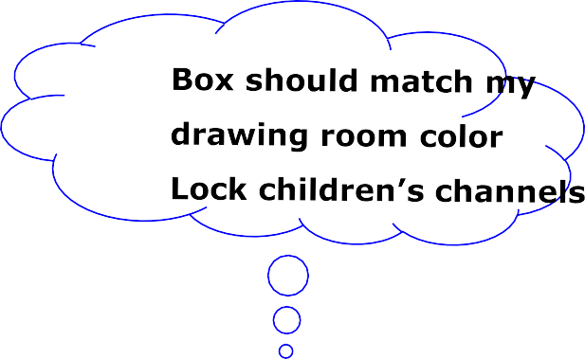



Different stakeholders….So different requirements
Two Remotes!
PIP
Plasma TV -Sharp picture AV in and out
Surround sound
Low Price
Easy to fix repairs
Hope it’ll be easy to
operate

Slide 7
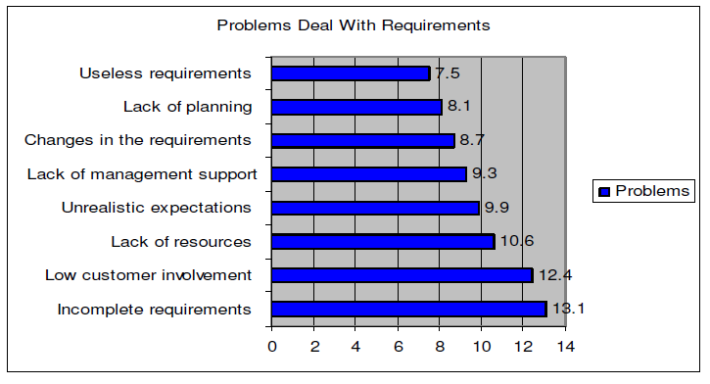
6.3 Challenges in Requirement Gathering
Requirement Problems are the single No.1 reason for projects to fail.
According to the Standish Group’s 1995 CHAOS survey, the top two “project impaired” factors were incomplete requirements and lack of user involvement.

Slide 8
6.4 Why do we need good requirements?
Why do we need the requirement phase?
What is it supposed to achieve?
Ensures Completeness of Product
Meets Business needs
Granularity in Req. &
Better Estimates
Cost & Schedule Predictability
Reduced Changes later in the Life Cycle
Manage Budget ,Reflect as
good team with skills
a
Meets Project Goals
Better Consensus amongst Stakeholders
Faster Sign offs
Reduced total cost of
ownership
Reduce future maintenance cost

Slide 9
6.4.1 Characteristics & Impact of bad Requirements
Characteristics of defective
Requirements :
Lack of Cohesiveness
Lack of Completeness
Lack of Correctness
Lack of Consistency
Lack of Project Relevance
Lack of Testability, Usability,
Validatability
Ambiguous
Impact of bad Requirements :
Function failure
Extensively over budget
Extensively past schedule
Extensively reduced scope
Poor quality applications
Not considerably used when
delivered
Sometimes getting cancelled

Slide 10
6.5 Requirements Engineering
Requirements Engineering is a disciplined, process-oriented approach to the definition, documentation, and maintenance of software requirements throughout the software development life cycle
Software requirements engineering is made up of two major processes:
“Requirements Development” and “Requirements Management”
Requirements development involves all of the activities that are part of eliciting, analyzing, specifying, and validating the requirements
Requirements management involves the activities that are part of requesting changes to the baselined requirements, performing impact analysis for the requested changes, approving or disapproving those changes, and implementing the approved changes

Slide 11
6.6 Functional & Non-functional Requirements
Functional Requirements | Non-functional Requirements
It specifies the input and output behaviour of a systems. It defines how software behaves to meet user needs. Example : Functional requirements of a health insurance company include : Determining Claimant Eligibility Paying Claims Calculating Premium | It represents quality attributes of the system : Availability, Maintainability, Performance, Portability, Reliability, Robustness, Security, Scalability etc. Examples: It should be easy to see the history of transactions The system should be available 99.9% of the time The system should use SSH public-key cryptography to authenticate the remote computer and allow the remote computer to authenticate the user, if necessary The system should be able to serve at the most 100 concurrent users

Slide 12
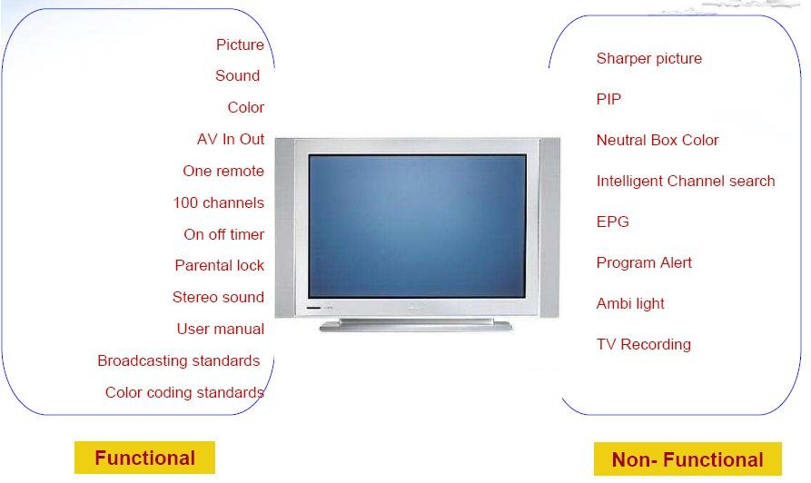
Functional Vs Non-Functional Requirements

Slide 13
6.7 Non Functional Requirements: FURPS +
Functionality Usability Reliability Performance Supportability
+ other such quality attributes

Slide 14
6.8 Stable and Volatile Requirements
Stable Requirements
They are related to the core activities of the system and its domain
For example, in an organization there will be requirements concerned with
employees, departments, payroll etc.
Volatile Requirements
These are requirements that are likely to change during the system development process or after the system has been become operational
Examples of volatile requirements are requirements resulting from organization’s leave policies or Income Tax policies enforced by the country’s government bodies

Slide 15
6.9 Baselining Requirements
The requirements are baselined at the end of the Requirements
Development phase & ideally signed-off by the customer
A requirements baseline is:
A snapshot in time of a set of requirements
Used as a mechanism to track changes as the project progresses
Constitutes agreement on scope between customer and development team
Scope drives estimate, schedule, staffing, deadlines
New baselines are typically created at major project milestones

Slide 16







Baselining Requirements (Cont..)
Customers, Users, Management
REQUIREMENTS
Elicit, Analyze, Represent, Validate, Approve
Requirement Development
Baselined Requirements
t
Requirement Managemen
revised requirements
Customers Users Management
Requirements Change Process
Project Changes

Slide 17
6.10 Requirements Traceability
It is one of the essential activities of good requirements management
Requirement traceability helps in assessing the impact of requirements
change
Traceability is used to track the relationship between each unique product- level requirement and its source
“The degree to which a relationship can be established between two or more products of the development process, especially products having a predecessor-successor or master-subordinate relationship to one another.”
The IEEE Definition

Slide 18
6.11.1 Requirement Traceability Matrix
RTM is a table containing requirements of a project and their relation to the
engineering work products
It ensures completeness in translating requirements to the delivered work
products
Advantages
Ensures completeness of testing against requirements
Facilitates the impact analysis of the requirements change on all the related
work products
Enables scope analysis for regression testing
Helps judging requirements stability from a customer
Helps to analyze Requirements creep
Suggested Tools
Rational Requisite Pro
Excel Sheet (Traceability template)

Slide 19
6.11.2 Requirement Traceability Matrix – Example
Example : XYZ Banking Application
This is a site that aims at computerizing the business process of XYZ bank. The following are the business targets that are to be achieved :
Step 1: Business Requirement Document (BRD) :
BR ID | Module Name | Roles Involved | Description
BR_1 | Login | Customer Manager | A customer can login using login module. A Manager can login using login module.
BR_2 | Enquiry | Customer Manager | A customer can view balance of his accounts only. A manager can view balance of all customers who come under his supervision.
BR_3 | Fund Transfer | Customer Manager | A customer can transfer funds from his ‘own’ account to any destination account. A manager can transfer funds from any account under his supervision.
BR_4 | Loan Process | Customer Manager | A customer can access loan information and apply for loan. A manager can grant, reject, suggest changes to the loan request under his supervision.

Slide 20
Requirement Traceability Matrix – Example
Below is our Technical Requirement Document (TRD) based on the interpretation of the Business Requirements Document (BRD)
Step 2: Technical Requirement Document (TRD) for BR_1 (Login)
TR ID | Module Name | Description
TR_01 | Login Module | User ID and Pwd must not be blank
TR_02 | Login Module | If User ID and password are valid. Login.
TR_03 | Login Module | The Pwd field should not allow copy paste from any source.

Slide 21
Requirement Traceability Matrix – Example
Step 3: On the basis of Business Requirement Document (BRD) and Technical
Requirement Document (TRD), testers start writing test scenarios.
Test Scenarios :
Test Scenario ID | Test Scenarios
TS_1 | Verify with valid User Credentials
TS_2 | Verify with invalid User Credentials
TS_3 | Verify the length provided for the user name field
TS_4 | Verify the length provided for the Pwd field
TS_5 | Verify copying the Pwd from external file and pasting it into Pwd field.

Slide 22
Requirement Traceability Matrix – Example
Step 4: For each test scenario, write at least 1 or more test cases.
Test Cases :
Test Case ID | Test Condition | Test Steps | Test Data | Expected Result
TC_1 | To validate that user is able to login successfully with valid User ID & valid Pwd. | 1.Go to Login Page 2.Enter User ID 3.Enter Password 4. Click Login | user1 1234B | Login Successful
TC_2 | To validate that user is unable to login with invalid User ID & valid Pwd. | 1.Go to Login Page 2.Enter User ID 3.Enter Password 4. Click Login | sampleuser 1234B | Login Failure
TC_3 | To validate that user is unable to login with valid User ID & invalid Pwd. | 1.Go to Login Page 2.Enter User ID 3.Enter Password 4. Click Login | user1 samplePwd | Login Failure

Slide 23
Requirement Traceability Matrix – Example
Step 5: You can now start creating RTM.
Identify the Test scenarios, Technical Requirements and Business Requirements that the test cases are verifying.
BR ID | TR ID | TS ID | TC ID
BR_1 | TR_01 | TS_3
 |  | TS_4
 | TR_02 | TS_1 | TC_1
 |  | TS_2 | TC_2
 |  | TS_2 | TC_3
 | TR_03 | TS_5
BR_2
BR_3
BR_4
At this stage, the RTM can be used to find gaps. For example, in the above RTM,
you see that there are no test cases written for TS_3, TS_4, TS_5.
it will indicate the places where the test team needs to work some more to ensure
100% coverage.

Slide 24
Requirement Traceability Matrix – Example
Step 6: Expand the RTM to include test case execution status and defects.
BR ID | TR ID | TS ID | TC ID | Status | Defect ID
BR_1 | TR_01 | TS_3 | TC_5 | Pass
 |  | TS_3 | TC_6 | Fail | D_05
 |  | TS_4 | TC_7 | Pass
 | TR_02 | TS_1 | TC_1 | Pass
 |  | TS_2 | TC_2 | Fail | D_11
 |  | TS_2 | TC_3 | Pass
 | TR_03 | TS_5 | TC_10 | Fail | D_02

Slide 25
6.11 Requirements Change
Users can propose requirements change at any stage of SDLC.
Requirements change because :
Understanding of the problem improved : Customer’s expectations change once they see
the product taking shape
Initial elicitation activities are imperfect : We failed to ask the right people the right questions at the right time.
The priority of requirements from different viewpoints change during the development process
Business needs evolve
The users changed their perceptions : Customers may specify requirements from a
business perspective that conflict with end-user requirements
The external environment changed : The business and technical environment of the system changes during its development
We either failed to create or follow a process to help manage change.

Slide 26

6.11.1 Change Management Process
Establish a formal process for managing changes to the system
requirements
 | Impact Analysis
Change
CCB Approval
Implement
Change
Update plan, schedule

Slide 27
Change Management Process
Identify potential change
Require new functionality
Encounter problem
Request change
Do functional impact assessment upon any change request
Analyze change request
Determine technical feasibility
Determine costs and benefits
Evaluate change
Obtain approval from customer on scope of change, impact & efforts needed
Plan change
Analyze change impact
Create planning
Implement change
Execute change
Propagate change
Test change
Update requirement artifacts with new
requirement
Release change
Review and close change
Verify change
Close change

Slide 28
6.11.2 Requirement Creep
"Scope creep (also called requirement creep and feature creep) in project management refers to uncontrolled changes or continuous
growth in a project’s scope. This can occur when the scope of a project is
not properly defined, documented, or controlled."
Why does Requirement Creep occur ?
Poor requirement analysis
Not involving customers early though
Insufficient detailing on the complexity of the project
Lack of change control
Gold Plating
Unwillingness to say no to a client

Slide 29
Requirement Creep (Cont..)
Even when there is a clearly defined project scope, one must be aware
that Requirement creep can still occur during project development.
Requirement creep tends to additional requirements needed to achieve the new objectives. This can overwhelm the capacity of the resources allocated to the project resulting into project missing deadlines, budgets or complete failure.
Therefore, preventing requirement creep and managing requirement creep is the key to successful project management.

Slide 30
Measures to control Requirement Creep
Following are some of the common measures those can be used to
minimize requirement creep
Utilize various techniques for more thoroughly defining user requirements up front
Involve the customers in the earliest stages of the project possible
Achievable goals should be set
Prioritize requirements into must-haves versus nice-to-haves
Project managers have to learn when to say no and when to say yes
When the client wants to change or add a requirement, the change or addition
should be analyzed for resource, cost, and schedule impacts
Perform constant internal review to make sure the project is on track and within
scope
Set a timeline or due date for all tasks
Have a tracking system for tasks, due dates, and action items

Slide 31
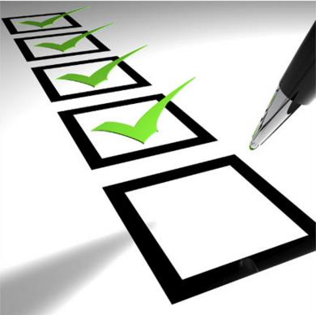
Review Question
Question 1: Which of the non functional requirements can ensure that the application should be available for German & Japanese users?
Question 2: In which of the requirement gathering patterns, requirements are specified in detail and passes thru multiple reviews and sign-offs?
Question 3: Volatile Requirements are likely to change during the system development process or after the system has been become operational. (T/F)
Question 4: The requirements are baselined at the beginning of the Requirements Development phase & ideally signed-off by the development team. (T/F)
Question 5: Which type of requirement traceability is used to validate whether the project is evolving in the desired direction and for the right product?

